Slide 1
AVL Tree
By
(Prof.) Dr. Aparna Kumari

Slide 2
Introduction
AVL Tree is also a Binary Search Tree but it is balanced tree.
Here balanced means the difference between height of right
subtree and left subtree must be -1 OR 0 OR +1.
In AVL Tree every node will have one extra information
known as BALANCE FACTOR.
BalanceFactor = HeightOfRightSubtree – HeightOfLeftSubtree

Slide 3
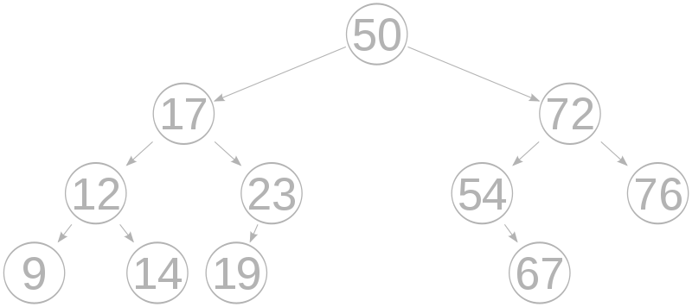
The AVL tree is named after its two inventors, G.M. Adelson-Velsky and E.M. Landis, who published it in their 1962.
Example

Slide 4
After every insertion / deletion we need to check the BALANCE FACTOR
If it is other than -1 or 0 or +1 then we perform ROTATION to make the
Tree Balance.
Note
All AVL Trees are Binary Search Trees but All Binary Search Trees need not be AVL Tree
All Binary Search Trees are Binary Trees but All Binary Trees need not be Binary Search Tree

Slide 5
Rotations
Left Rotation (LL)
Single
Rotation
Right Rotation (RR)
Left Right Rotation (LR)
Double
Rotation
Right Left Rotation (RL)

Slide 6
LL Rotation
Insert: A , B , C
0
1
2
A
0
0
1
B
0
C

Slide 7
RR Rotation
Insert: C , B , A
0
1
2
C
0
0
1
B
0
A

Slide 8
LR Rotation
Insert: C , A , B
0
1
2
C
0
0
1
A
0
B

Slide 9
RL Rotation
Insert: A , C , B
0
1
2
A
0
1
0
C
0
B

Slide 10
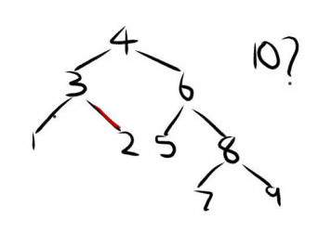
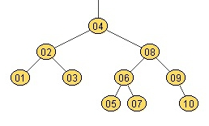
Example
Construct AVL Tree by inserting 1 to 10
1
2
3

Slide 11
Deletion
Deletion in AVL Tree have 3 cases
1. Deleting node without any child
2. Deleting node with one child
3. Deleting node with two children

Slide 12
1. Deleting node without any child
Step – 1:
Find given node in AVL Tree by performing search operation
Step – 2:
Remove given node in AVL Tree by using ‘delete’ operator
Step – 3:
Check balance factor of each node in AVL tree
Step – 4:
If tree is not balanced perform suitable Rotation operation to
make tree balanced

Slide 13
Deletion
Delete: 5
4
2
8
1
3
6
9
5
7
10

Slide 14
2. Deleting node with one child
Step – 1:
Find given node in AVL Tree by performing search operation
Step – 2:
Make a link between its Parent and its Child
Step – 3:
Remove given node in AVL Tree by using ‘delete’ operator
Step – 4:
Check balance factor of each node in AVL tree
Step – 5:
If tree is not balanced perform suitable Rotation operation to
make tree balanced

Slide 15
Deletion
Delete: 6
4
2
8
1
3
6
9
7
10

Slide 16
Deletion
Delete: 7
4
2
8
1
3
7
9
10

Slide 17
3. Deleting node with two children
Step – 1:
Find given node in AVL Tree by performing search operation
Step – 2:
Find the Smallest node in its Right Subtree
Step – 3:
Swap both given node and the Smallest node in its right subtree
Step – 4:
Remove given node in AVL Tree by using ‘delete’ operator
Step – 5:
Check balance factor of each node in AVL tree
Step – 6:
If tree is not balanced perform suitable Rotation operation to
make tree balanced

Slide 18
Deletion
Delete: 4
4
2
9
1
3
8
10

Slide 19
Assignment
Construct AVL Tree by inserting 10 to 1
Write applications of AVL Trees
Explain Deletion in AVL Tree in detail

Slide 20
Thankyou !!!

